Slide 1
Kubernetes Training Updated 20 September 2019

Slide 2
Kubernetes > Agenda
Big picture
Basics
Objects
AKS
Q&A

Slide 3
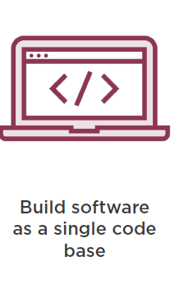
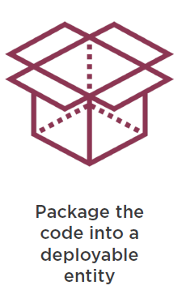
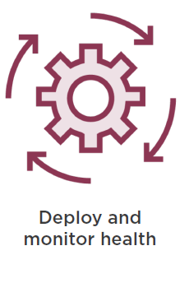
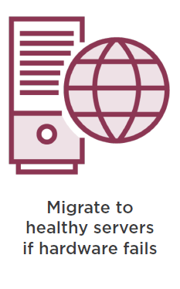
Kubernetes > Big Picture > Traditional Software Development

Slide 4
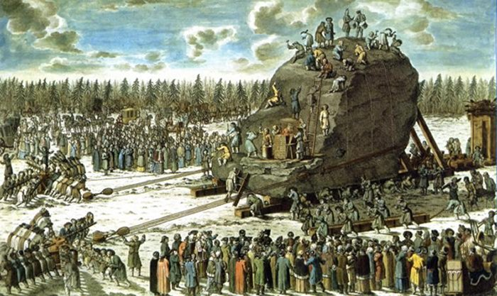
Kubernetes > Big Picture > Traditional Software Release

Slide 5
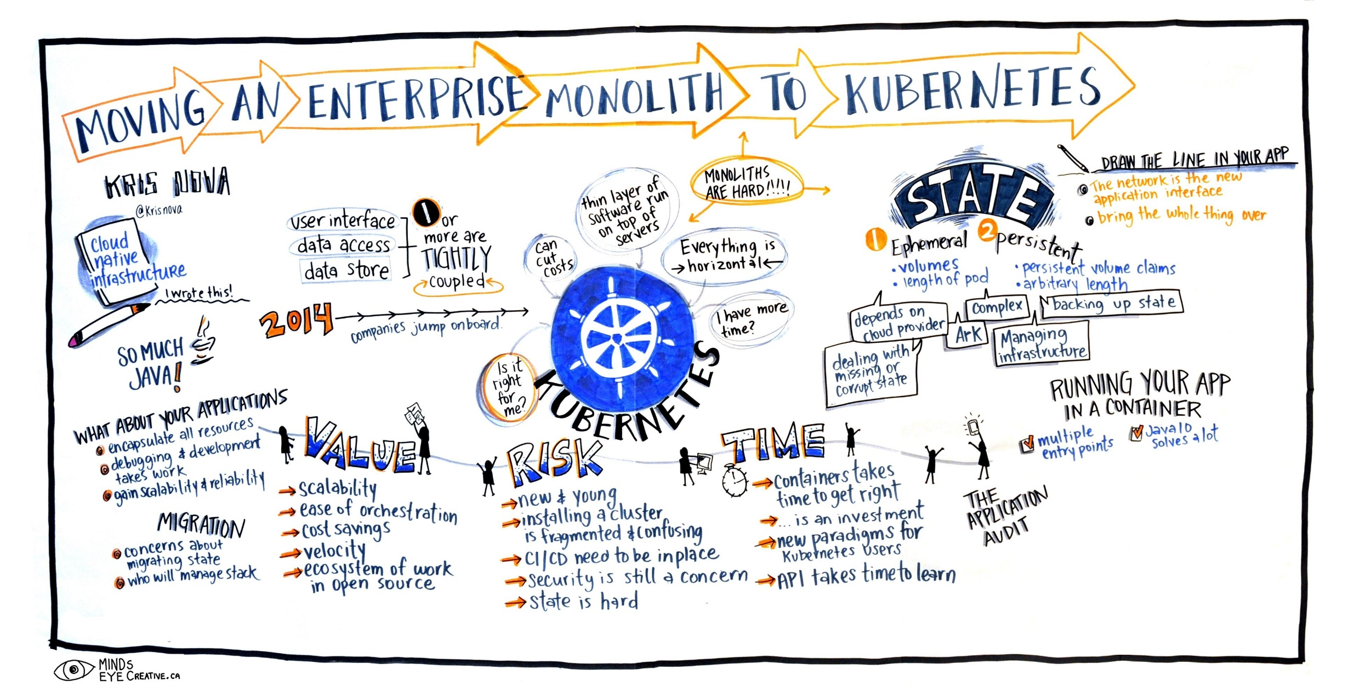
Kubernetes > Big Picture > A better way?

Slide 6
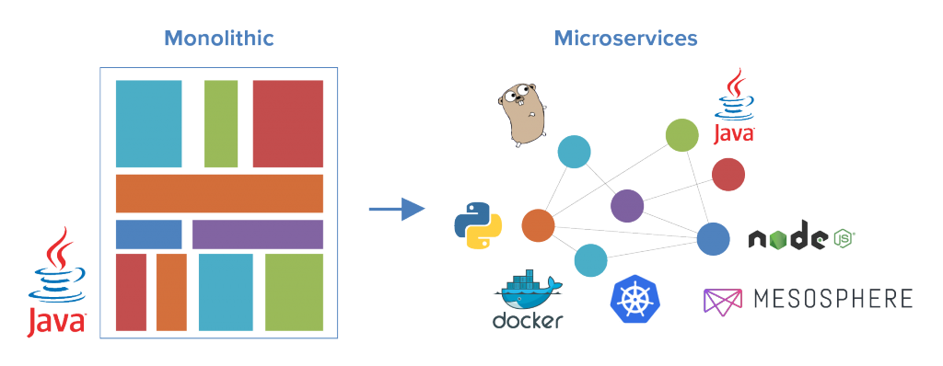
Kubernetes > Big Picture > Monolith-2-Microservices

Slide 7
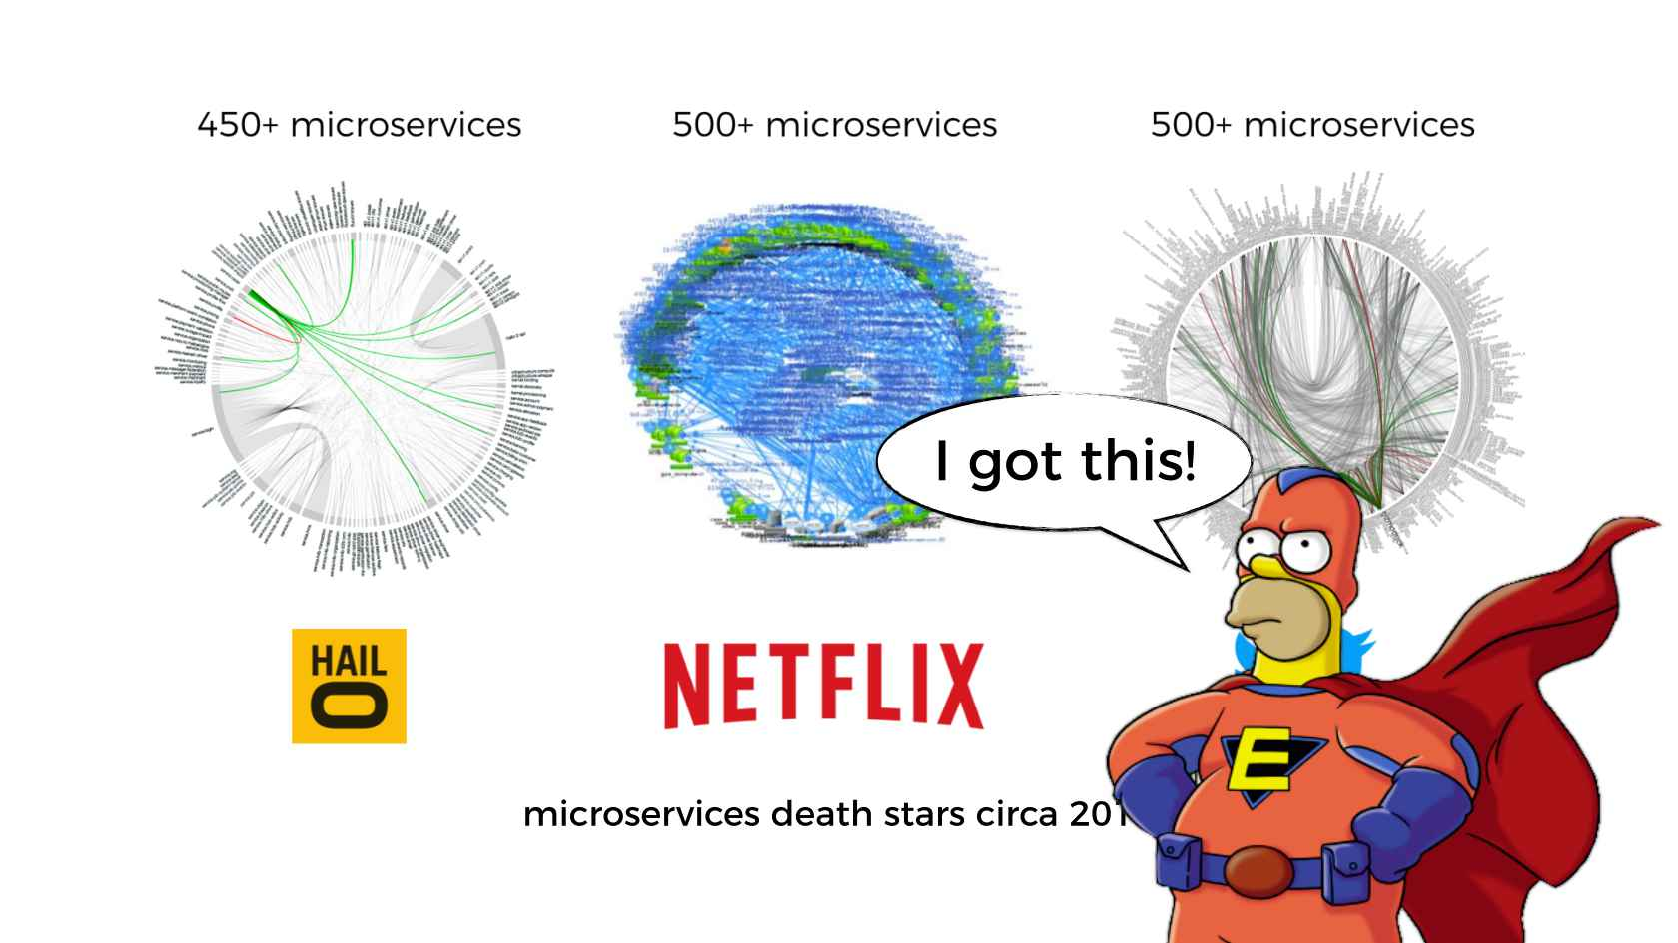
Kubernetes > Big Picture > Microservices

Slide 8
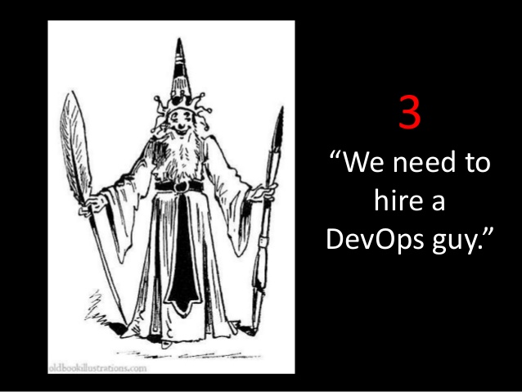
Kubernetes > Big Picture > DevOps

Slide 9

Kubernetes > Big Picture > DevOps > Challenge

Slide 10
Kubernetes > Big Picture > DevOps > Proposal
We need automation, which includes automatic scheduling, automatic configuration, supervision, and failure handling.

Slide 11
Kubernetes > Big Picture > DevOps > Solution

Slide 12
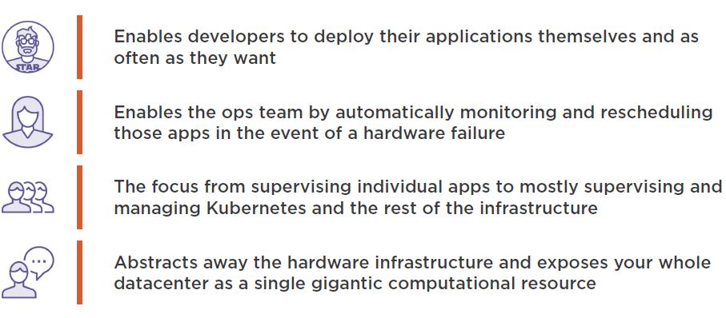
Kubernetes > Big Picture > DevOps > Solution > Benefits

Slide 13

Kubernetes > Basics

Slide 14
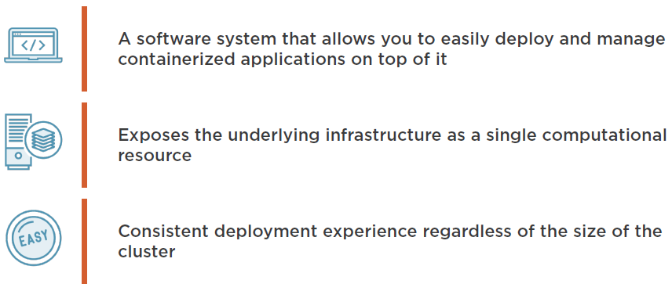
Kubernetes > Basics > What is it?

Slide 15
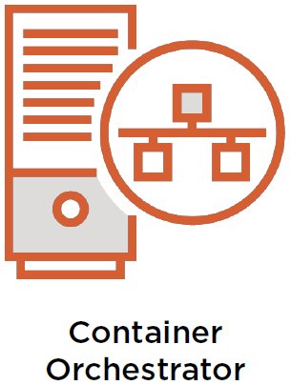

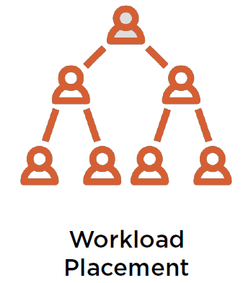
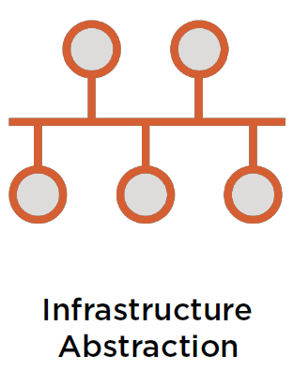
Kubernetes > Basics > What does it do?
A key facet of Kubernetes is workload placement to control how, when and where containers are deployed.
Kubernetes provides desired state configuration in code and leaves it for the platform to ensure that the system meets that desired state.
Kubernetes core responsibility is to orchestrate container-based applications.
Kubernetes provides infrastructure abstraction (networking, storage, etc).

Slide 16
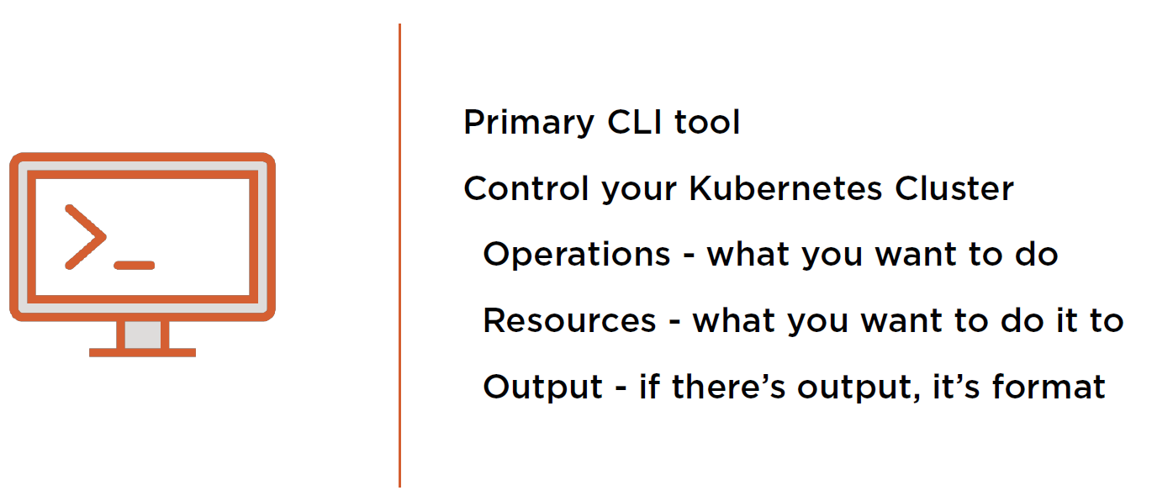
Kubernetes > Basics > kubectl

Slide 17


Kubernetes > Basics > Demo

Slide 18
Kubernetes > Basics > Namespaces
Most Kubernetes resources (e.g. pods, services, replication controllers, and others) are in some namespaces. However namespace resources are not themselves in a namespace and low-level resources, such as nodes and persistent volumes, are not in any namespace.
Namespaces can be used to provide quotas and limits around resource usage and have an impact on DNS names that Kubernetes creates internal to the cluster.
If no namespace is specified when interacting with Kubernetes through kubectl, the command assumes you are working with the default namespace, named default.

Slide 19
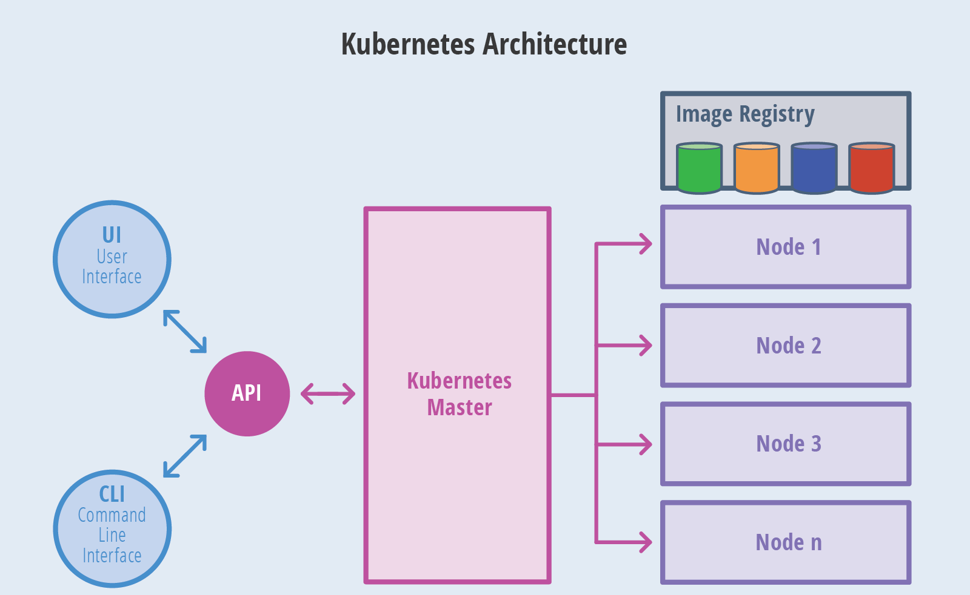
Kubernetes > Basics > Architecture

Slide 20
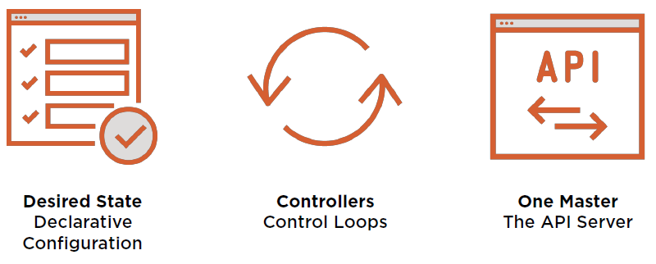
Kubernetes > Basics > Core Principles

Slide 21
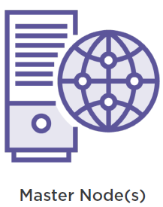
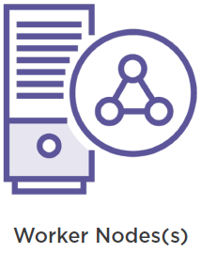
Kubernetes > Basics > Node Types

Slide 22
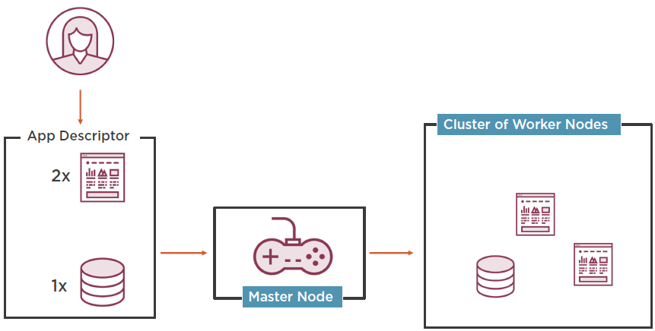
Kubernetes > Basics > System Overview
Developer submits a Deployment descriptor.
Worker nodes run application containers and communicates changes back to master node via local kubelet.
Master node looks at the Deployment descriptor and schedules applications for worker nodes.

Slide 23
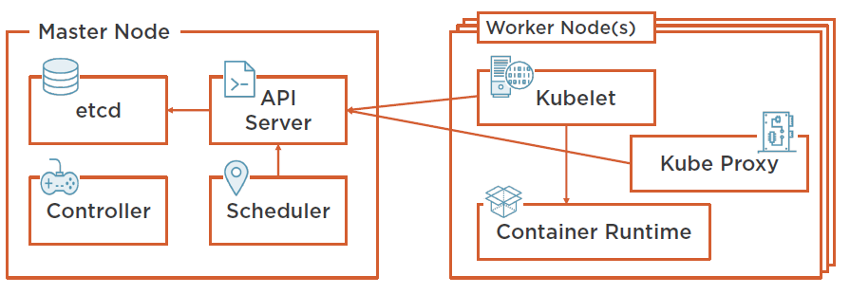
Kubernetes > Basics > Cluster Architecture
Communicates with API server and manages containers.
Load balances network traffic.
Cluster configuration.
RESTful API which acts as a communication hub for the cluster.
Cluster level functions. E.g. replication, tracking worker nodes, handling node failure, etc.
Assigns applications to work nodes.
Docker or rkt.

Slide 24
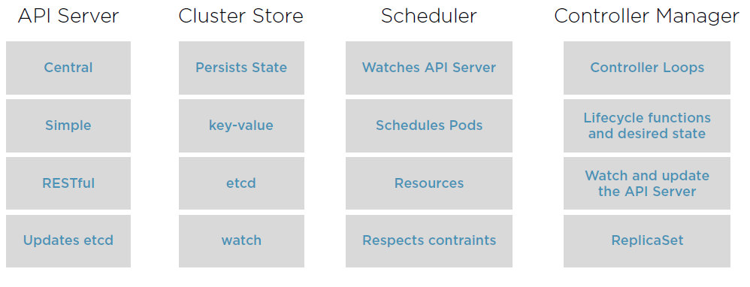
Kubernetes > Basics > Master Node Control Plane Components

Slide 25
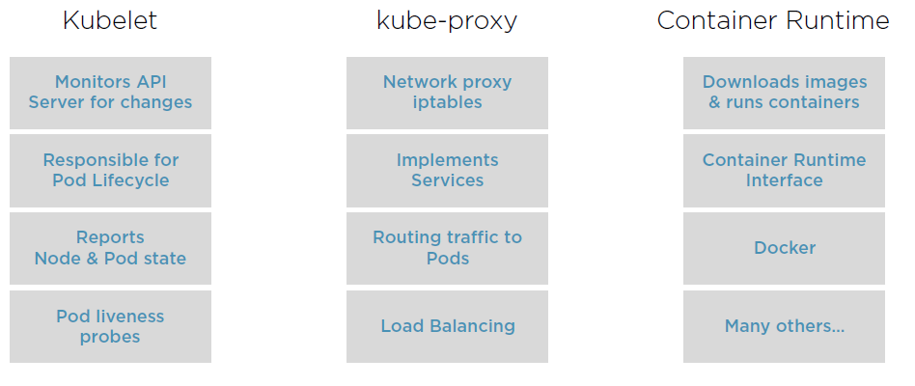
Kubernetes > Basics > Worker Node Control Plane Components

Slide 26
Kubernetes > Basics > Workflow
Package your application in to one or more containers.
Push those images to an image registry.
Scheduler schedules containers on available worker nodes.
Post AppDescriptor to the Kubernetes API Server.
Kubelet instructs worker nodes to download container images.
Kubelet instructs worker nodes to run the containers.

Slide 27
Kubernetes > Basics > Demo

Slide 28
Kubernetes > Basics > Benefits
Simplifies Application Deployment

Slide 29
Kubernetes > Basics > Benefits
Better Hardware Utilization

Slide 30
Kubernetes > Basics > Benefits
Health Monitoring with Self-Healing
Health Monitoring with Self-Healing

Slide 31
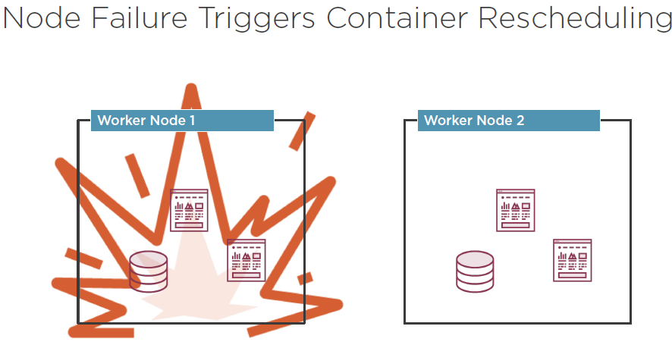
Kubernetes > Basics > Benefits
Health Monitoring with Self-Healing

Slide 32
Kubernetes > Basics > Benefits
Health Monitoring with Self-Healing
Automatic Scaling

Slide 33
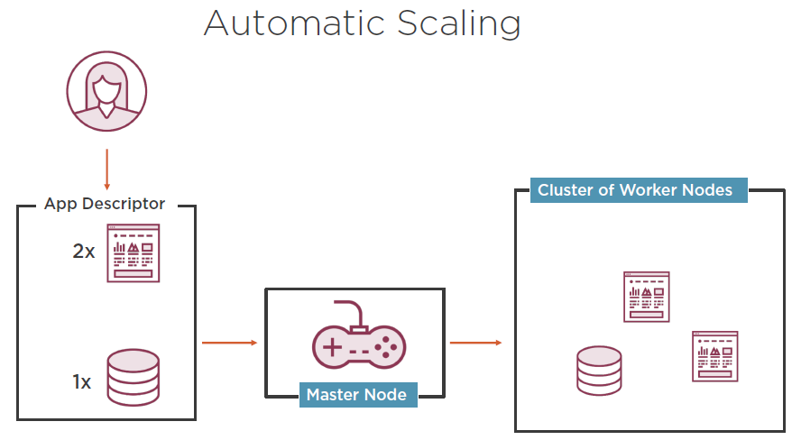
Kubernetes > Basics > Benefits
Health Monitoring with Self-Healing

Slide 34
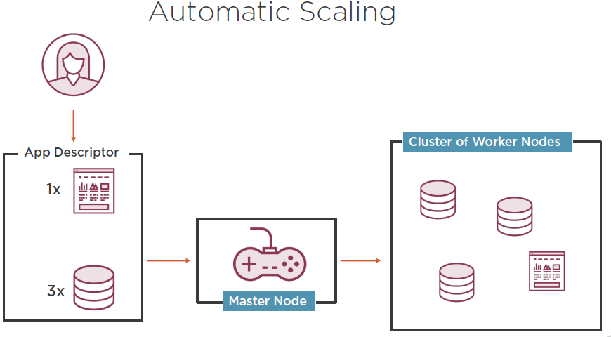
Kubernetes > Basics > Benefits
Health Monitoring with Self-Healing

Slide 35

Kubernetes > Basics > Hands-on

Slide 36
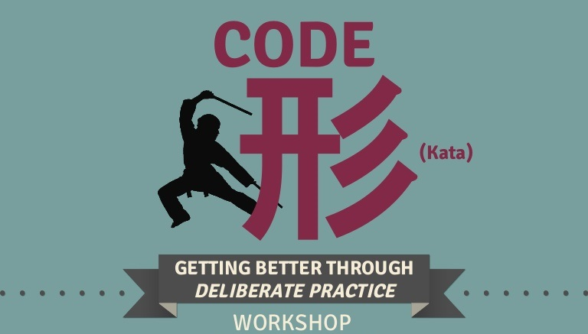
Kubernetes > Basics > Code Kata #1
Exercise files @ http://codekata.orsted.dk/kubernetes/1

Slide 37
Kubernetes > Basics > Code Kata #2
Exercise files @ http://codekata.orsted.dk/kubernetes/2

Slide 38
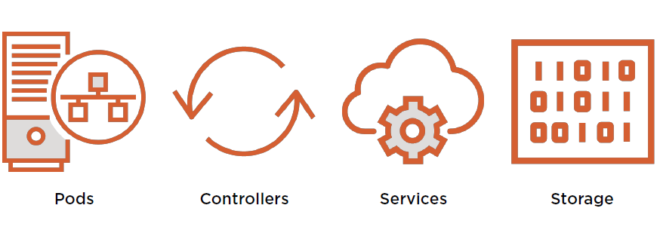
Kubernetes > Objects

Slide 39
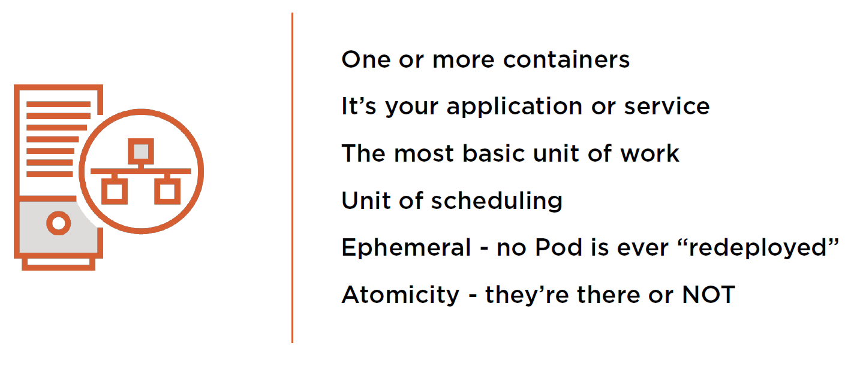
Kubernetes > Objects > Pods

Slide 40
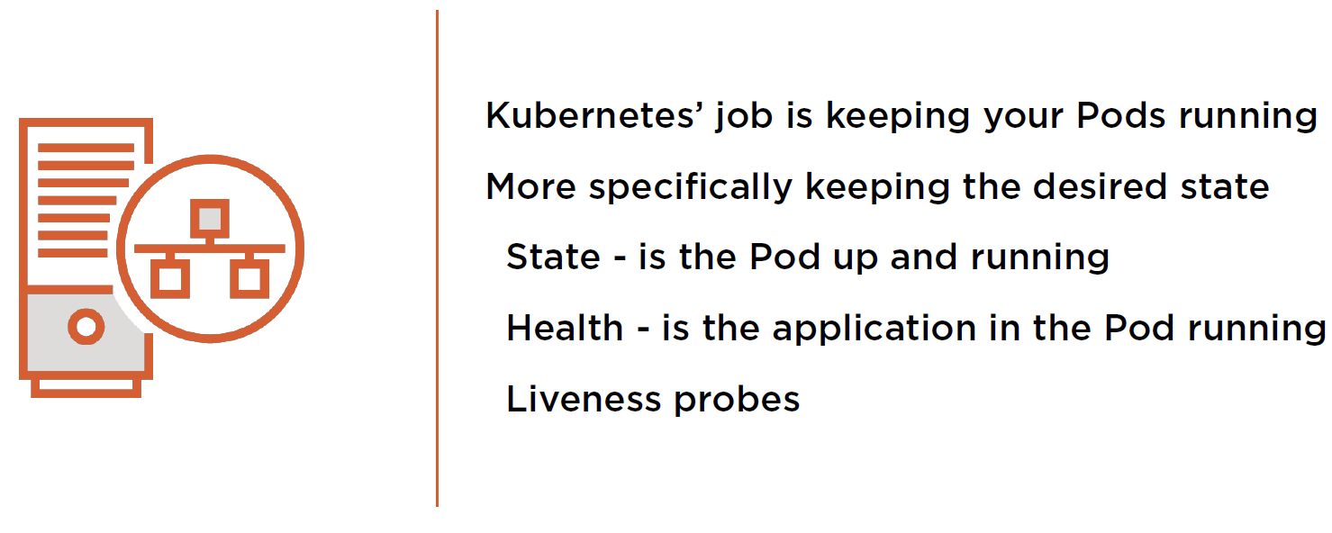
Kubernetes > Objects > Pods

Slide 41
Kubernetes > Objects > Controllers
So how does Kubernetes
manage my Pods’ state?

Slide 42
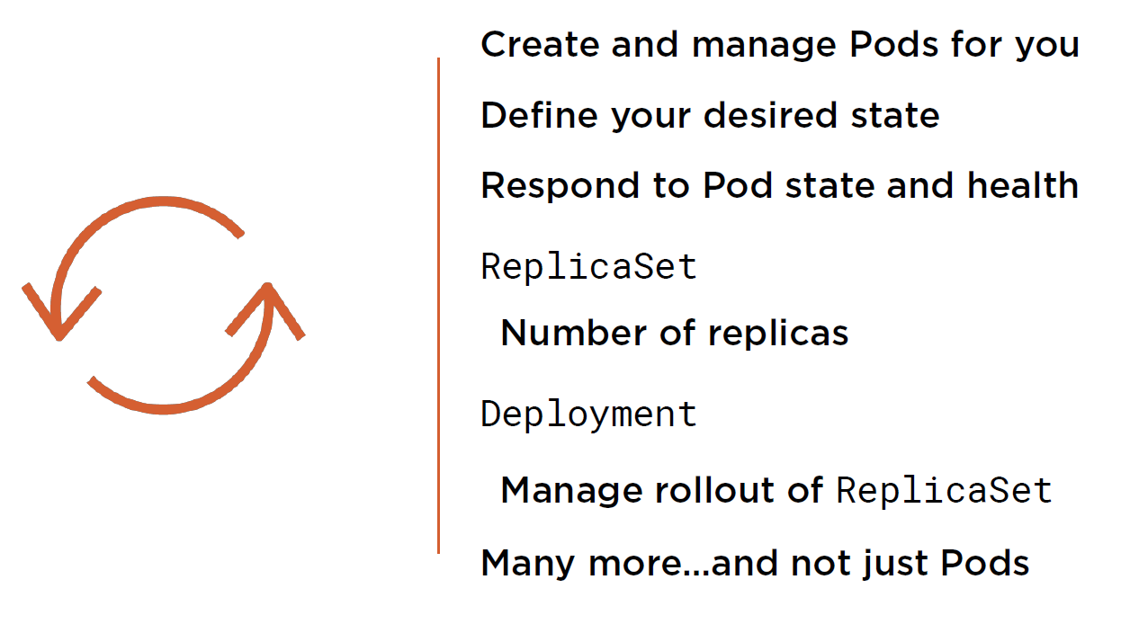
Kubernetes > Objects > Controllers

Slide 43
Kubernetes > Objects > Controllers
So how does Kubernetes add
persistency to all this ephemerality?

Slide 44
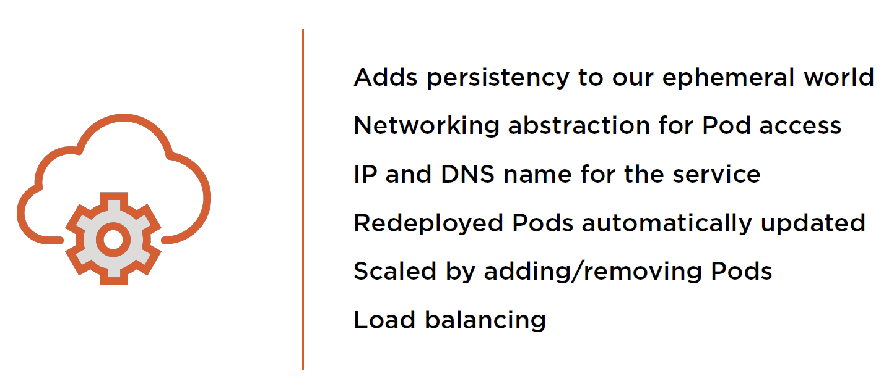
Kubernetes > Objects > Services

Slide 45
Kubernetes > Objects > Controllers
What about my data?
Where’s that stored in Kubernetes?

Slide 46
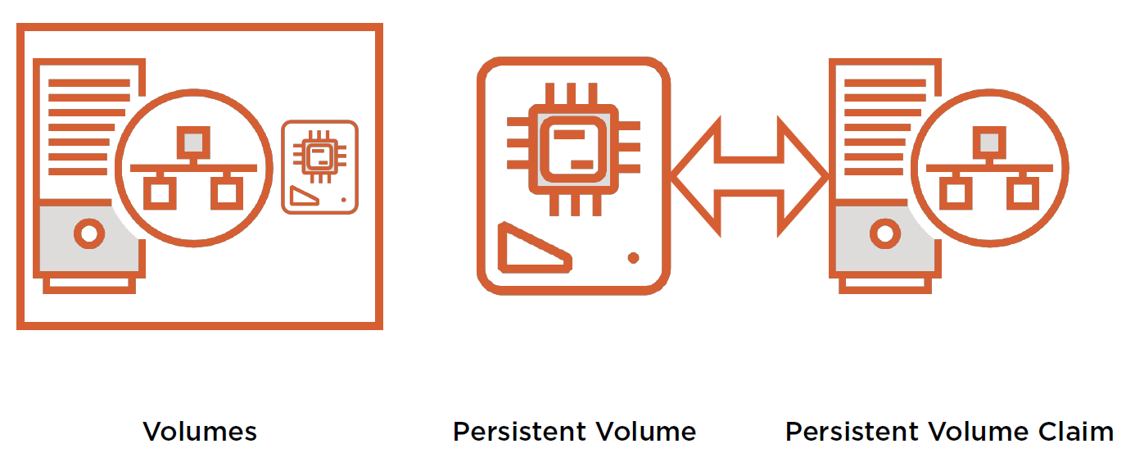
Kubernetes > Objects > Storage

Slide 47
Kubernetes > Objects > Networking
So how does Kubernetes connect all these objects?

Slide 48
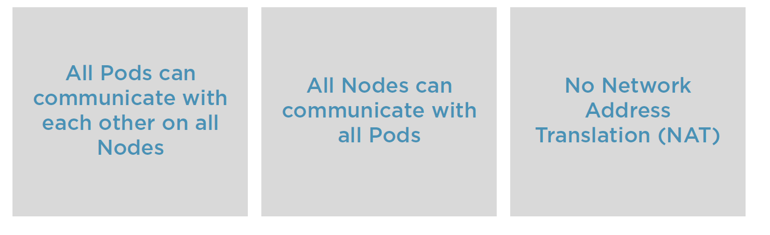
Kubernetes > Objects > Networking

Slide 49


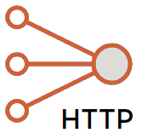
Kubernetes > Objects > Networking
Pod
Pod
IP
IP
Bridge
Kube-proxy
Pod
Layer 2 or 3
Inside a Pod.
Pod to Pod within a node.
Pop to Pod on another node.
External service.
Service
localhost
Pod
Kube-proxy
IP

Slide 50

Kubernetes > Q/A

